Slide 1

What is Data?
The Foundation of Information
Definition: Data is a collection of raw facts, figures, or observations.
Forms of Data: It can be text, numbers, images, audio, or video.
Data vs. Information: Data is the raw material; when processed and organized, it becomes useful "Information."
Example: "100" is data. "Sales for today = 100 units" is information.

Slide 2

Why Do We Need to Store Data?
Moving Beyond Memory
Persistence: To ensure information is not lost when a computer or application is turned off.
Analysis: To study past trends and make future business predictions.
Access: To allow multiple people to view or edit the same information simultaneously.
Security: To protect sensitive information from unauthorized access.

Slide 3
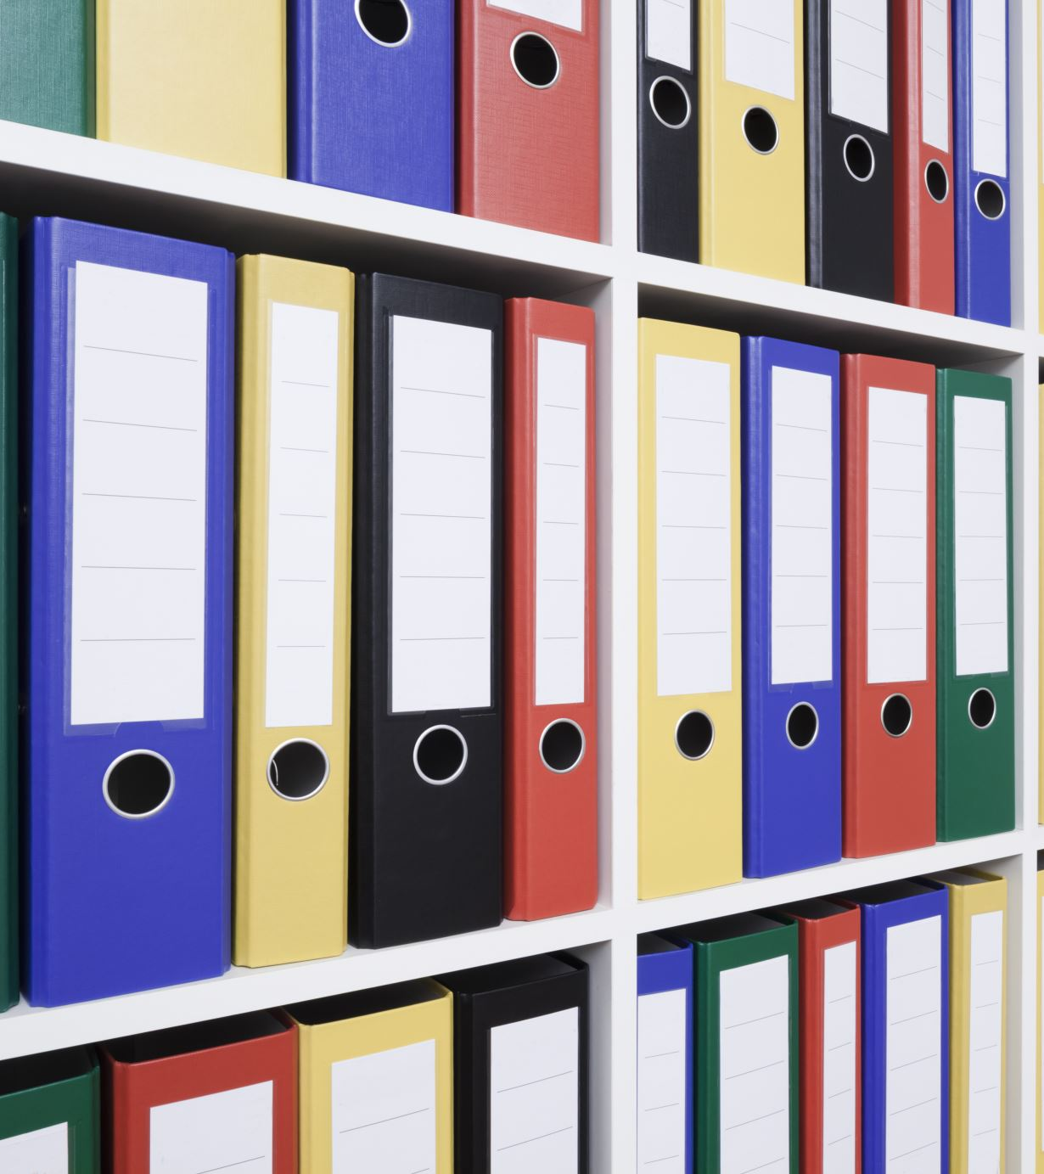
What is a Database?
The Digital Filing Cabinet
Definition: A database is an organized collection of structured data.
Purpose: It allows for easy storage, retrieval, and management of data.
Analogy: If a library is the database, the books are the data records.
Key Benefit: It turns a messy pile of files into a searchable, efficient system.

Slide 4
Real-World Examples of Databases
Databases are Everywhere
Banking: To store customer accounts, transactions, and balances.
E-commerce: To manage product listings, customer reviews, and order history.
Social Media: To store user profiles, posts, likes, and followers.
Healthcare: To keep track of patient records, appointments, and prescriptions.

Slide 5
What is a DBMS?
Database Management System
Definition: A DBMS is software that acts as an interface between the user and the database.
Function: It allows users to create, delete, and update data without needing to know the complex technical details of how the data is stored.
Key Role: It ensures that data is consistent, secure, and easily accessible.

Slide 6
Functions and Advantages of DBMS
Data Integrity: Ensures data follows specific rules (e.g., a phone number must be digits).
Concurrency: Multiple users can access the data at the same time without errors.
Backup and Recovery: Automatically saves copies of data to prevent loss.
Security: Controls who can see or change specific parts of the data.

Slide 7
File System vs. DBMS
Feature | File System (Excel/Folders) | DBMS (SQL Database)
Data Redundancy | High (Duplicate data is common) | Low (Minimizes duplication)
Access | Usually one person at a time | Multi-user access
Search Speed | Slow for large data | Very fast indexing
Security | Minimal | Robust and granular
Data Volume | Small to Medium | Massive (Terabytes of data)

Slide 8

What is SQL?
Structured Query Language
Definition: SQL is the standard language used to communicate with databases.
Purpose: It is used to "query" (ask questions), update, and manage data.
Standardization: While different versions exist, the core commands are the same across almost all database software.
Pronunciation: Can be pronounced as "S-Q-L" or "Sequel."

Slide 9
Why SQL is Used
Common Use Cases
Data Retrieval: "Show me all customers who spent more than $500 last month."
Data Entry: "Add a new product to the inventory list."
Data Updates: "Change the price of Item X because it is on sale."
Data Deletion: "Remove users who haven't logged in for 5 years."

Slide 10

How Data is Stored in a Database
The Logic of Organization
Data is not just a "blob" of text; it is organized logically.
Databases contain Tables.
Tables contain specific information about a particular subject (e.g., Customers, Orders, Products).

Slide 11

Concept of Tables, Rows, and Columns
The Building Blocks
Table: A collection of related data held in a structured format.
Columns (Fields): The vertical part of the table. They define what kind of data is stored (e.g., Name, Date, Price).
Rows (Records): The horizontal part of the table. Each row represents one single unique entry (e.g., one specific customer).

Slide 12
What is RDBMS?
Relational Database Management System
Definition: A type of DBMS that stores data in tables that are related to one another.
The "Relational" Part: Data in one table can be linked to data in another table using "Keys."
Commonality: Most modern databases used in business today are RDBMS.

Slide 13
Characteristics of RDBMS
The Rules of the System
Tabular Structure: Data is always in a Row/Column format.
Primary Key: Every table should have a unique identifier for each row (like an ID number).
Relationships: Tables are linked to prevent data duplication.
Data Integrity: Strict rules to ensure data remains accurate over time.

Slide 14

Examples of Popular RDBMS
Industry Standards
MySQL: Open-source, very popular for web development and beginners.
Oracle: High-end, powerful, used by large corporations.
Microsoft SQL Server: Deeply integrated with Windows/Enterprise environments.
PostgreSQL: Advanced open-source database known for complex data handling.

Slide 15
Introduction to MySQL
Our Learning Tool
What it is: One of the most popular RDBMS in the world.
Why we use it: It is free, fast, and easy to install.
Ownership: It is currently owned and maintained by Oracle Corporation.
Usage: Used by giants like Facebook, YouTube, and Pinterest.

Slide 16
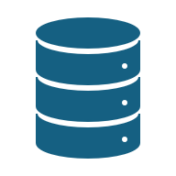
What is a Database in MySQL?
The Container
In MySQL, a "Database" is a container that holds a set of related tables.
Think of the Database as a Folder and the Tables as Files inside that folder.
You must create or select a database before you can create any tables.

Slide 17
What is a Table in MySQL?
The Data Grid
A table is where the actual data lives.
When creating a table, you must define the Columns and the Data Types.
Data Type Examples:
Is this column for text?
Is it for whole numbers?
Is it for dates?

